Slide 1
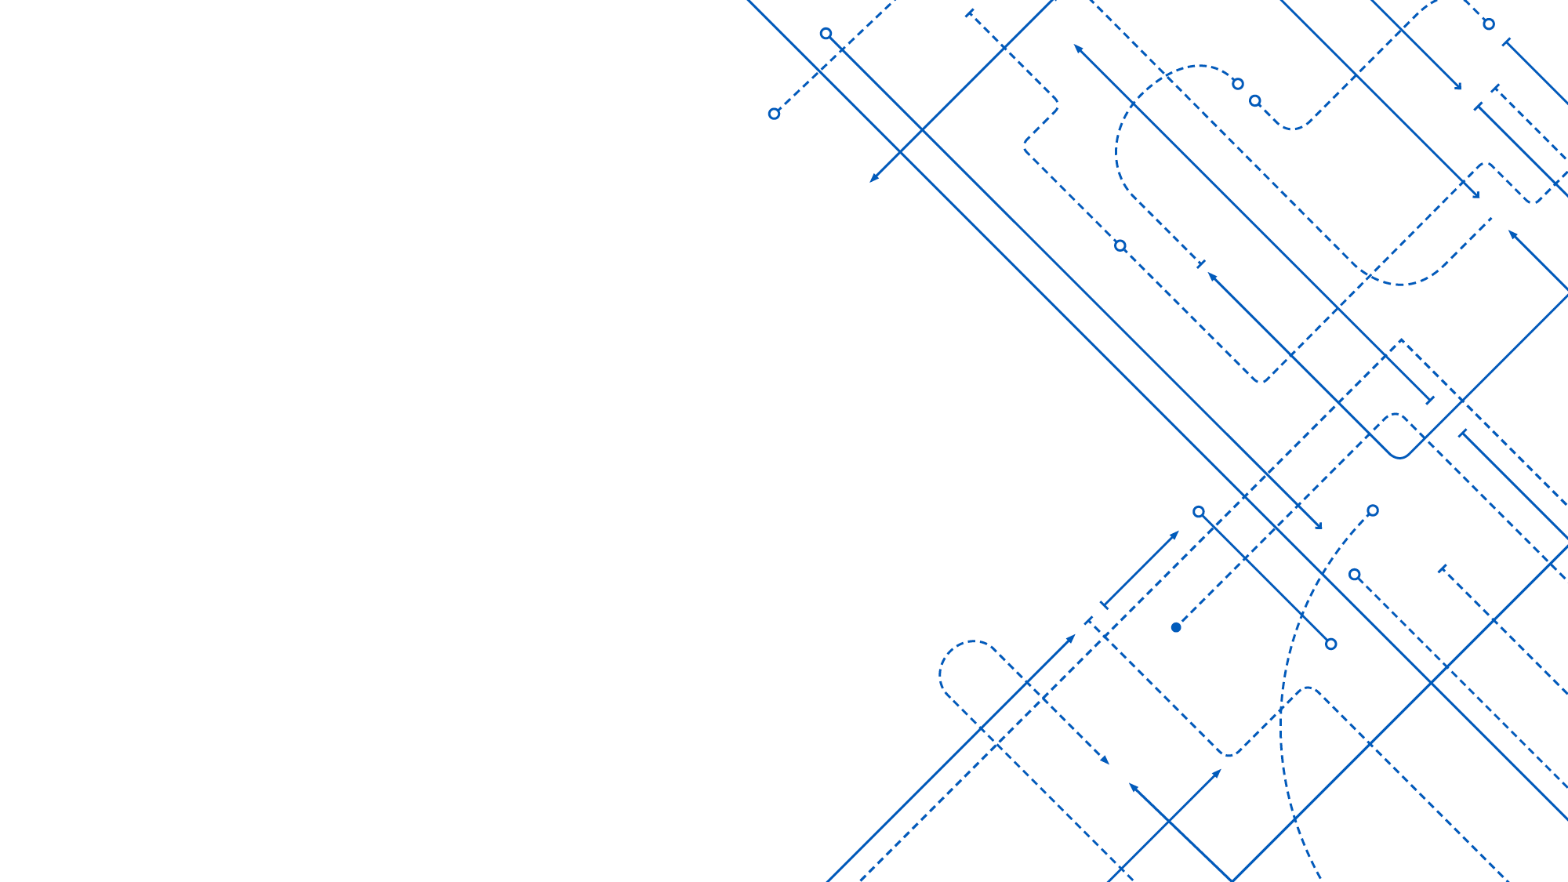
Supportive CSE Bulls
Ann Konnayil
Asheeque Chericham Veettil
Kadambare Jayandran
Ganesh Nayar
Mathew Thengumpallil Jose
Rahul Nair
Vimochana Kummur

Slide 2
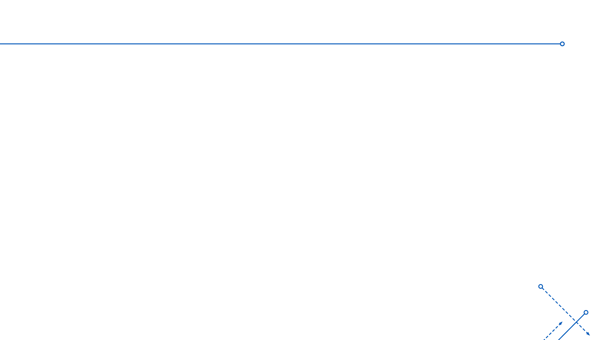
Problem
Worldwide migrant patterns and the ensuing demographic shifts is not accurately represented in a clinical trial and biomedical database participant makeup.
The research problem we are trying to address is to ensure an accurate representation of all the variability that constitutes a population. Given that the data that is currently available at the present isn’t an accurate representation of reality, we aspire to generate a virtual population/synthetic patient data that is inclusive.
2

Slide 3
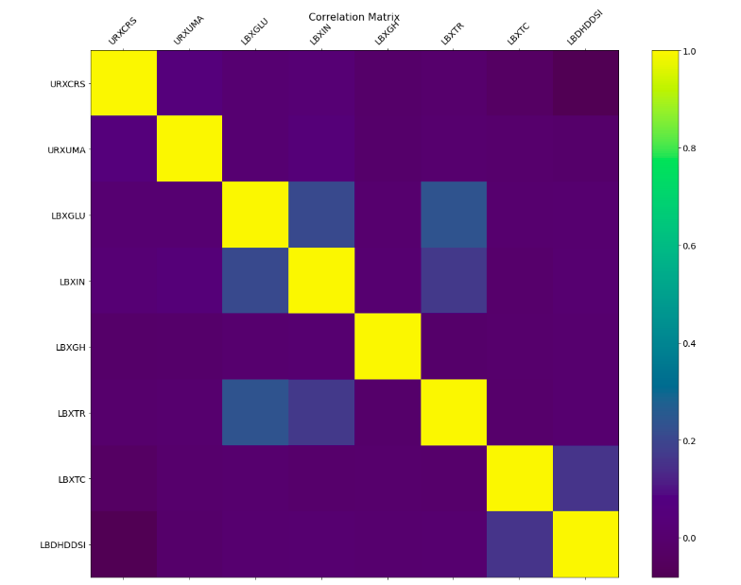
Data selection and pre-processing
NHANES data from years 2009 to 2018 were collected.
Features used are:
Albumin, urine (ug/mL)
Creatinine, urine (mg/dL)
Fasting Glucose (mg/dL)
Insulin (uU/mL)
Glycohemoglobin (%)
Triglyceride (mg/dL)
Total Cholesterol (mg/dL)
Direct HDL-Cholesterol (mg/dL)
All the rows containing null values were removed and dataset containing around 13000 samples was created.
The correlation between the variables were plotted to find similarities.

Slide 4
Machine learning approach to create virtual population
Variational AutoEncoders to learn the parameters of the population and create a sample set similar to the actual population using the learned latent space to data relationship.
Three phases:
Selecting any one variable at a time and generating data from a latent space
Generate the joint distribution of the multidimensional data and validate it with the test set
Joint distribution of data across categories of interest, such as race, age, and so on
Our VAE contains 3 hidden layers for the encoder and decoder.
The latent dimension is kept at 2 and the model is trained at 1000 epochs.
Batch normalization is done to handle the covariate shift in layers.

Slide 5
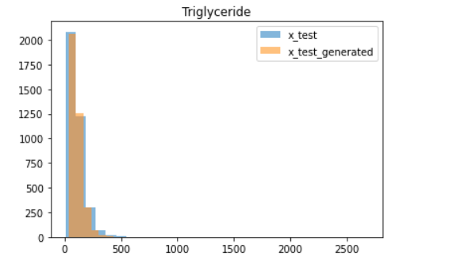
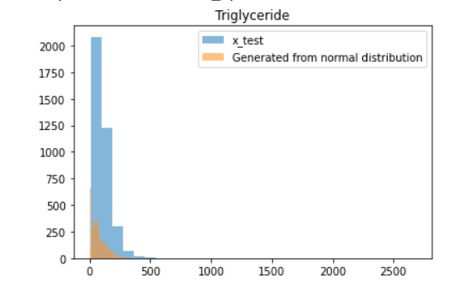
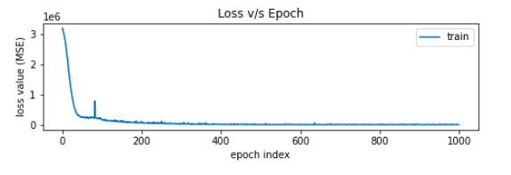
Training
To train the one-dimensional VAE model, triglyceride feature was used.
Encoder created a latent space with dimension = 2.
When triglyceride was given as the input, the model generated the same output as the input, making the model behave like a identity matrix.
When 3000 samples were taken from normal distribution and given to the decoder model, it generated triglyceride data for 3000 individuals using the latent space created using VAE.

Slide 6
Limitations and further study
Currently the null values were removed from dataset.
Better pre-processing techniques can be used to handle null values.
Min-max normalization did not improve the result, It actually worsened the model output. This should be further analyzed.
Model performance should be improved since the generated data doesn’t seem to cover the whole range of input data.
Next stages would be to use VAE to learn the joint distribution of physiological features.

